Slide 1


Slide 2


2 Years of Windows 10 Lessons Learned
Peter Löfgren
Senior Executive Consultant @ TrueSec
Twitter: @LofgrenPeter
Blog: www.infrastructurepilot.com

Slide 3
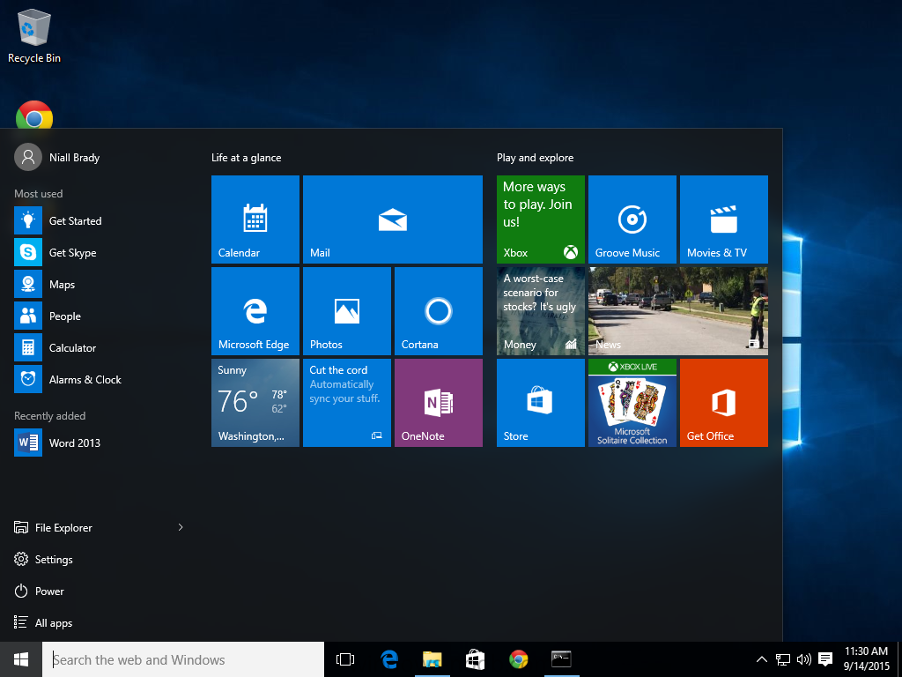
Windows 10 - 1507
RTM!
29 July 2015
Cortana
Edge
PowerShell 5.0
Start-Menu

Slide 4
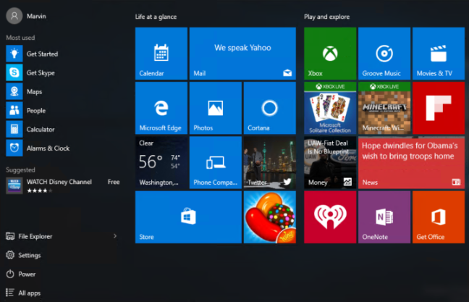
Windows 10 - 1511
Enterprise ready
Device guard
Credential Guard
Consumer Experience
Bitlocker XTS-AES

Slide 5
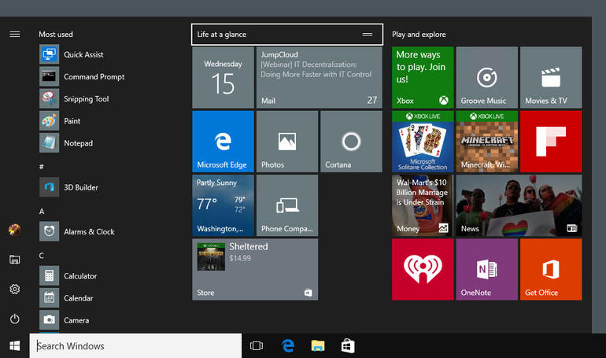
Windows 10 - 1607
First proper release
Edge extension support
Subsystem for Linux
Shared PC Mode
App-V included
UE-V included

Slide 6
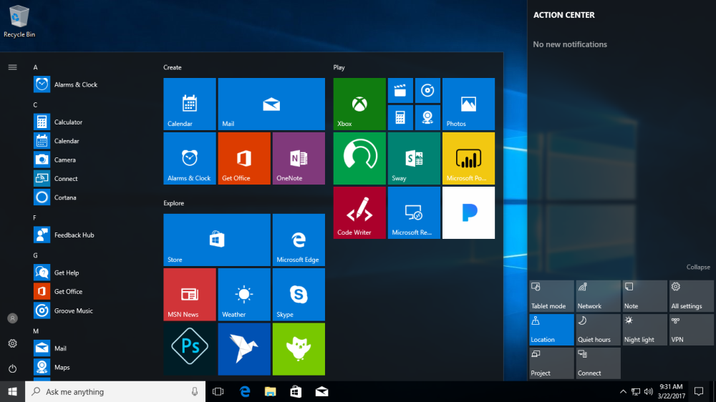
Windows 10 - 1703
Last CB/CBB release
Delivery Optimization (Peer-To-Peer)
MBR2GPT
Windows Insider for Business

Slide 7
Windows 10 - 1709
First Semi Annual Channel
Windows Defender Application Guard
Window Defender Exploit Guard
Windows AutoPilot

Slide 8

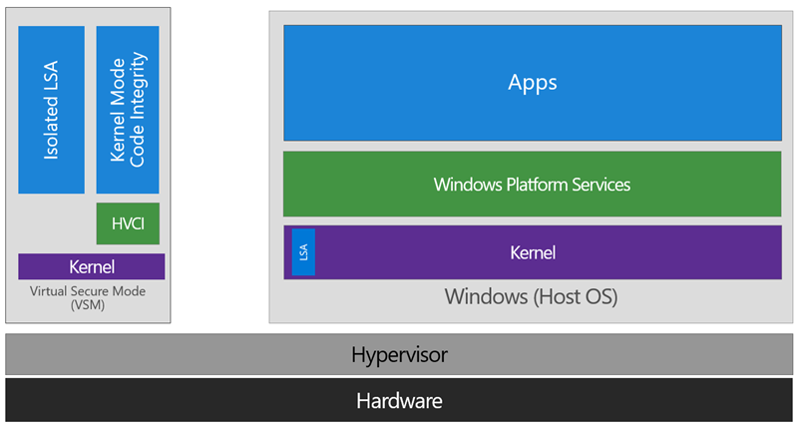
Device Guard
Virtual Secure Mode
UEFI in Native Mode
Windows 64bit
SLAT and Virtualization Extensions
TPM is recommended.
GPO: Turn On Virtualization Based Security
Don’t forget to monitor!

Slide 9
Device Guard Demo

Slide 10

IE Enterprise Mode
Improved Control and Website compatibility
Automatic switch between Edge/IE
Schema v1 vs v2

Slide 11
Enterprise Mode Demo

Slide 12


Windows feature upgrades
 | Task Sequence | Servicing Plan
Upgrade from Windows 7 or Windows 8.1 | Yes | No
Upgrade Windows 10 build-to-build | Yes | Yes
User experience | Task sequence progress | Software Update
Administrative effort: Content acquistion | Manually import OS upgrade packages and manual distribution | Content automtically acquired and distributed based on criteria
Administrative effort: deployment rings | Manually per deployment | Deployment automatically created based on criteria
Include drivers | Yes | Planned
Include language packs | Yes | Planned
Compatibility pre-assessment | Yes | Planned
Third-party disk encryption | Yes (custom) | Planned
Pre- and Post-actions | Yes

Slide 13
Windows feature update Demo

Slide 14
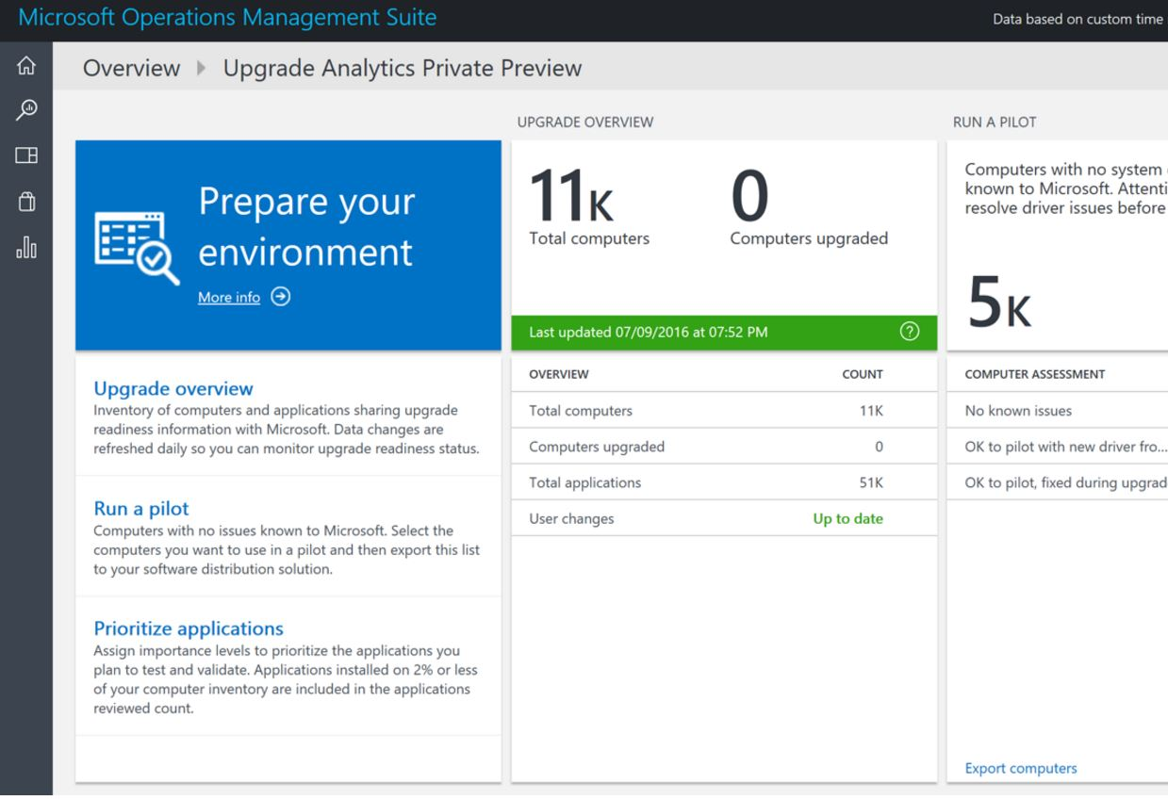
Upgrade Readiness
Microsoft Assessment and Planning Toolkit
Windows Analytics
Commerical ID
Telemetry
Notes:
https://docs.microsoft.com/sv-se/windows/deployment/upgrade/upgrade-readiness-get-started#deploy-the-compatibility-update-and-related-kbs
https://docs.microsoft.com/sv-se/windows/deployment/upgrade/upgrade-readiness-deployment-script

Slide 15
Upgrade readiness Demo

Slide 16
Q & A

Slide 17
Resources
Slides and demos from the conference will be available at github.com/nordicinfrastructureconference/2018 (bit.ly/2y7JhA3)

